Slide 1
WEBSITE
ABIC MANPOWER SERVICE CORP

Slide 2
Corporate Partners
Profile
Manpower Requisition
Labor Standard Checklist

Slide 3
Profile
Company Website Link
Company Name
Copy of SEC/DTI Certificate
Copy of Business Permit
Contact Person/Position/Email Address/Phone Number

Slide 4
Manpower Requisition
Employment Type: ____ Direct Hire ____ Outsourced
Vacant Position:
Job Category:
No of Vacancy:
Years of Experience: ____ None ____
Work Type: ____ Full Time ___ Part Time ____ Project Based ____ Contractual
Working Schedule: _____ Hours _______ Days
Working Location:
Salary Range: _______ to ________ Allowance: _______
Pay-out: ____________ and __________
Preferred Gender: ___ F ___ M ___ None
Job Description:

Slide 5
Manpower Requisition
Job Requirements & Qualifications:
__ Bachelor Degree Holder __ Vocational __ Experience Wise
__ License __ Certificates
__ Others
Target Date of Deployment: ____
Screening: ___ Face to Face ___ Virtual

Slide 6
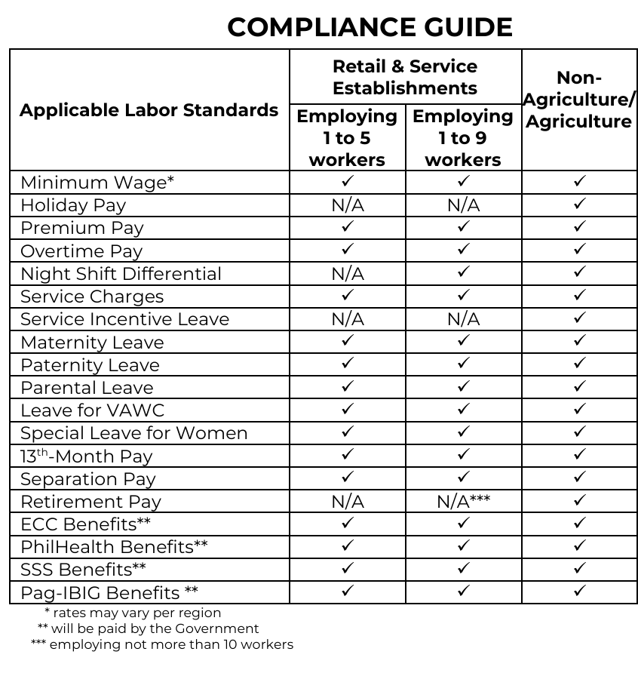
Labor Standard Checklist

